Slide 1
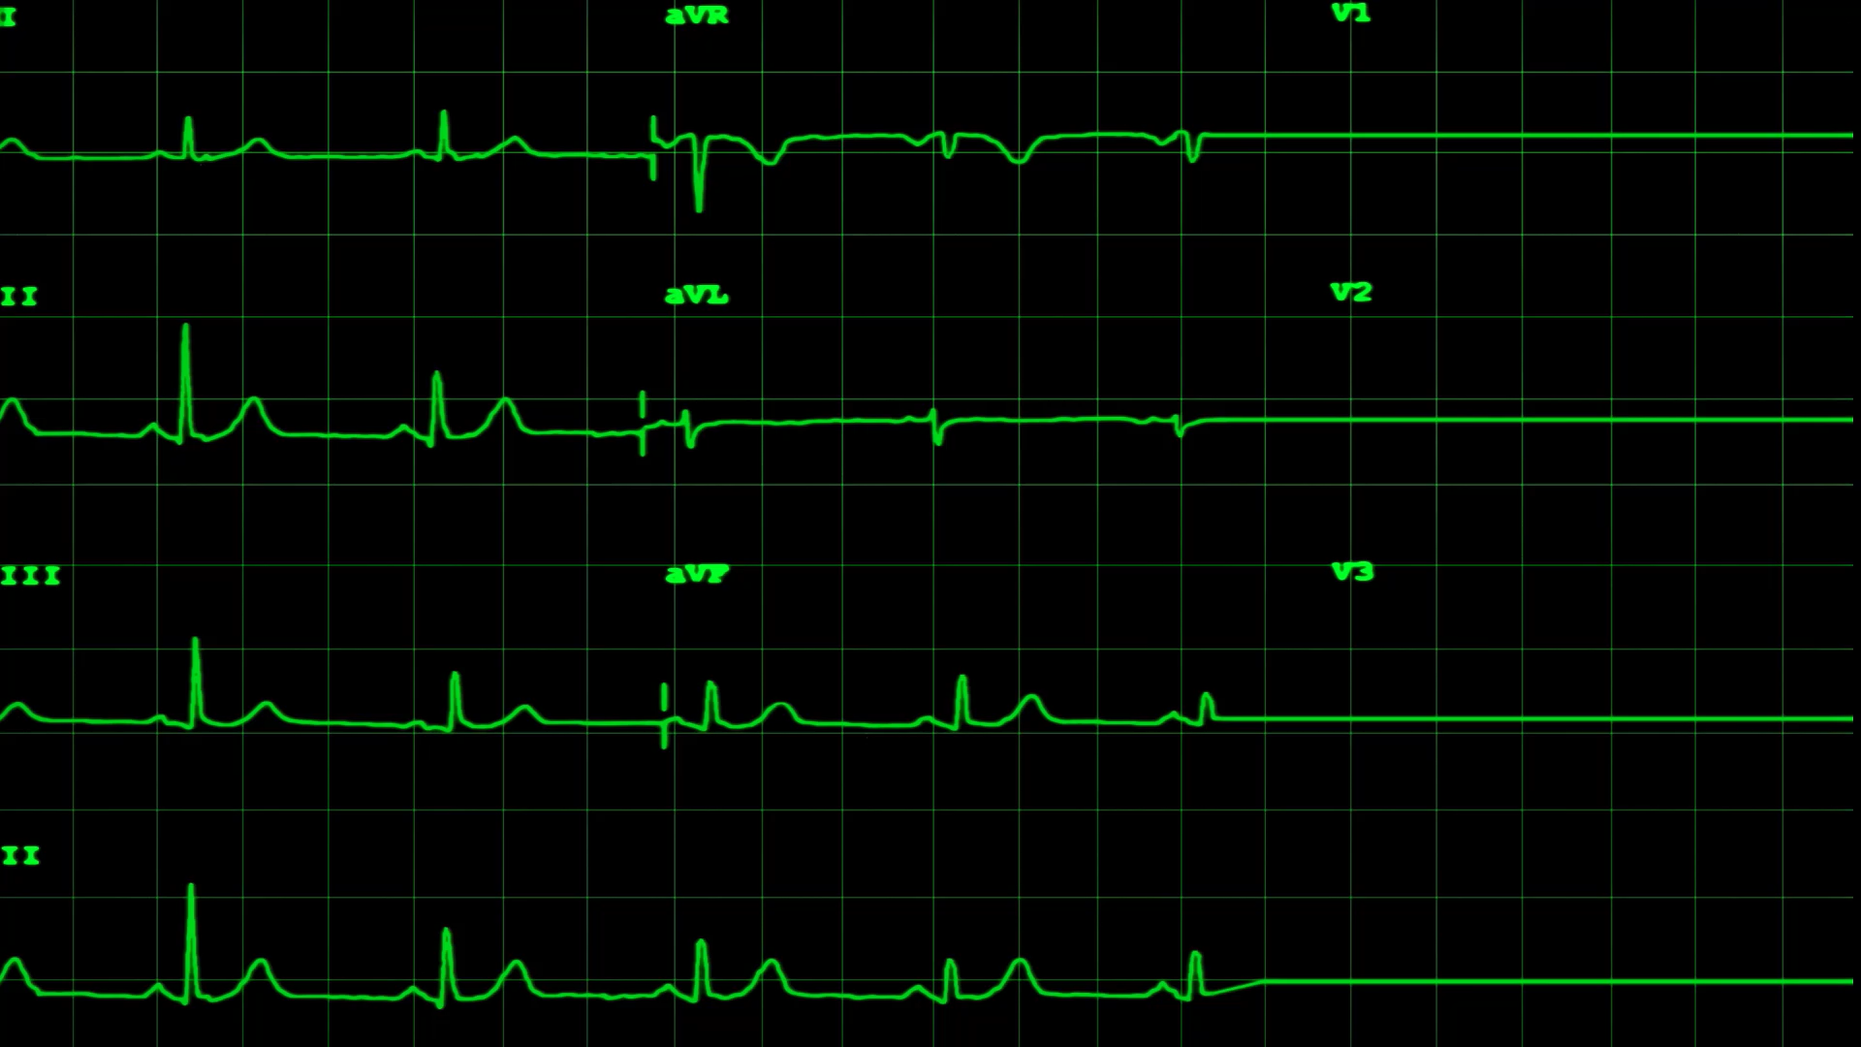
Phase 1, Module 7: Functions & The Modular Layer
Khyber AI Systems Engineer (KASE)
Welcome to Module 7. Today, we stop writing scripts and start writing Software. We are going to build isolated, reusable 'blocks' of code called Functions. In Phase 6, these functions will literally become the 'Hands' of your AI Agents.
Presented By: Zaryab Ahmad

Slide 2
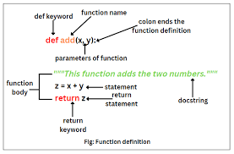
What is a Function?
What is a Function?
A function is a named, isolated block of code that performs exactly one specific task.
It acts like a mini-machine: Data goes in, it gets processed, and new data comes out.
AI Context: In Phase 6, your AI Agents will use these functions as their "Hands" (e.g., a function to search the web, a function to calculate math).

Slide 3
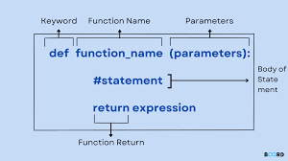

How Does It Work? (The Anatomy)
$def$, Inputs, and Outputs
def: The keyword that creates the function.
Parameters (Inputs): The variables the function needs to do its job.
return (Output): The final result the function hands back to the main system.
Type Hints: (: int, -> str) Telling the system what data types to expect.

Slide 4
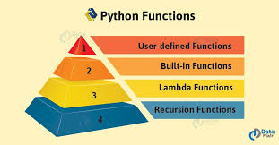
Types of Functions & Arguments
Built-in vs. Custom
Built-in: Functions Python wrote for you (print(), len(), type()).
Custom: Functions you design.
Argument Types:
Positional: Order matters.
Keyword: Specifically naming the input (age=25).
Default: Giving the parameter a fallback value if the user forgets to provide one.

Slide 5
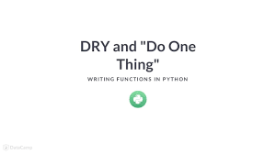
The DRY Principle (Why we use them)
Don't Repeat Yourself
The Problem: If you copy and paste the same 10 lines of code in 3 different places, you now have 3 places for a bug to hide.
The Solution: Write the code once inside a function, and call it 3 times.
Result: If you need to fix a bug, you only fix it in one place.

